Slide 1
Financial Performance Insights & Recommendations

Slide 2
Overview of Financial Performance
The financial dashboards provide a comprehensive analysis of revenue, costs, and profitability trends. The key performance indicators (KPIs) from both the Overview Dashboard and the Income Statement Dashboard reveal critical insights into the company's financial health.

Slide 3
Key Insights On Metrics
Metric | Value | Goal | Performance (vs. Goal)
Revenue | $3.62M | $1.52M | ↑ +137.94% (Exceeded Target)
Total COGS | $2.14M | $1.06M | ↑ +102.33% (Higher than Expected)
Gross Profit | $1.48M | $0.46M | ↑ +219.4% (Good Performance)
Gross Profit % | 40.83% | 30.42% | ↑ +10% (Better than Expected)
Net Profit | $572K | -$350K | ↑ +263.16% (Higher than Expected)
Net Profit % | 15.82% | 23% | ↓ Underperformed by -7.18%

Slide 4
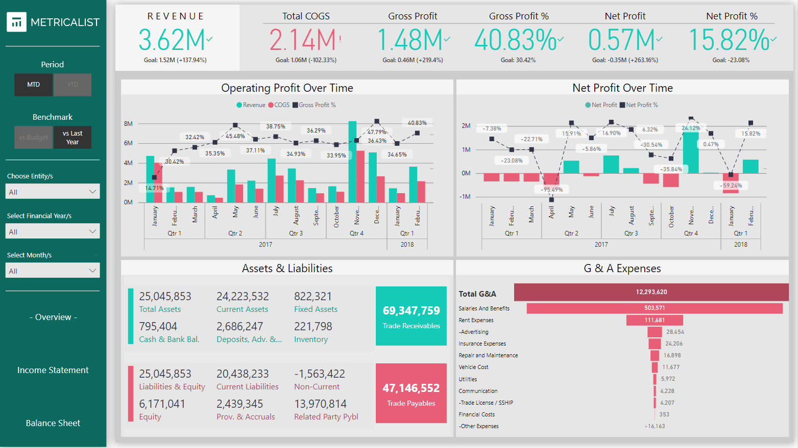
Profitability & Cost Efficiency
February and March had -95.49% and -23.08% net profit, indicating high Operational expenses.
October had a -35.84% net profit - operational inefficiencies increased costs.
December rebounded with 24.12% net profit, - improved financial health

Slide 5
Profitability & Cost Efficiency
From Assets and Liabilities:
High trade payables ($47.14M)
Trade receivables ($69.34M) -affecting cash flow, due to delays in customer payments impacting cash flow.
High current liabilities ($20.43M) - reducing profitability

Slide 6
Trend & Seasonality Insights
The Trend Analysis chart highlights revenue fluctuations throughout the year.
Low profit months (April, June) suggest seasonal dips or cost spikes.
November shows peak revenue, but the corresponding net profit percentage still indicates room for better cost control.
Discrepancies in budget forecasts vs. actual profit margins suggest inefficiencies in cost planning.

Slide 7
Identified Issues & Root Causes
High Cost of Goods Sold (COGS): While revenue is strong, increased costs are squeezing profit margins. This suggests inefficiencies in procurement, supplier pricing, or operational costs.
Elevated Expenses: Operating expenses ($905K) significantly impact net profit, highlighting areas where cost-cutting is necessary.
Seasonal Profitability Fluctuations: The trend graph indicates inconsistent profitability across the year, requiring better budget planning.

Slide 8
Recommendations & Solutions
Cost Optimization: Renegotiate supplier contracts to reduce COGS and improve gross margins. Identify cost-saving opportunities in operations.
Expense Reduction Strategies: Implement cost-control measures, particularly in high-expenditure areas (e.g., marketing, logistics, and administrative costs).
Revenue Diversification: Introduce strategies to maintain steady income during low-revenue months, such as promotions, bundling, or new product lines.
Profitability Monitoring: Regularly analyze KPIs, implement automated alerts for cost overruns, and adjust pricing models accordingly.

Slide 9
Conclusion
The financial overview indicates that while revenue is strong, high costs and expenses are limiting net profit growth. To improve profitability, the company must optimize COGS, reduce operational expenses, and refine seasonal financial planning. Implementing cost-effective strategies will enhance profit margins and drive long-term financial stability.

Slide 10
Thank you

